Slide 1
Local suicide prevention planning 2017
Notes:
This slide set can be adapted for local use. Depending on the audience, purpose of the meeting/discussion and the length of time available you may choose to edit some of the slides, or focus on particular aspects of suicide prevention.
In places the same information has been presented in different ways, offering a choice depending on your preference.

Slide 2
About this resource
This slide set has been produced by Public Health England to support local areas in their suicide prevention planning and action. It is intended for directors of Public Health, local authority leaders, chief executives and other senior officers and councillors.
Further resources available on PHE and NSPA’s websites:
Local suicide prevention planning: a practice resource
Identifying and responding to suicide clusters and contagion: a practice resource
Preventing suicides in public places: a practice resource
Preventing suicide among lesbian, gay and bisexual young people
Data on suicides by local authority is available in the Suicide Prevention Profile (also referred to as the Fingertips Tool)

Slide 3
Contents
National suicide prevention strategy and policy context
Ten essential things to know about suicide prevention
Understanding data
Strategy and action
Ideas and resources
Bereavement
Occupation
Quotes
Notes:
National suicide prevention strategy and policy context (slide 4 – 6)
Ten essential things to know about suicide prevention (slide 7 – 18)
Understanding data (slide 19 – 24)
Strategy and action (slide 25 - 36
Ideas and resources (slide 37 – 48)
Bereavement (38 – 43)
Occupation (44 – 47)
Resources (48)
Quotes (slide 48 – 56)
About PHE, About NSPA – end slides

Slide 4
Section 1
National suicide prevention
strategy and policy context

Slide 5
National suicide prevention strategy: further action in five areas
every local area to produce a multi-agency suicide prevention plan
better targeting of suicide prevention and help seeking in high risk groups
expand scope to include self-harm prevention
improve responses to bereavement by suicide and support services
improve data at national and local levels
Notes:
In January 2017 the third progress report of the cross-government suicide prevention strategy included an update to the 2012 strategy in 5 main areas:
Better and more consistent local planning and action by ensuring ever local area has a multi-agency suicide prevention plan, with agreed priorities and actions
Better targeting of suicide prevention and help seeking in high risk groups such as middle aged men, those in places of custody/detention or in contact with the criminal justice system and with mental health services
Expanding the scope of the national strategy to include self-harm prevention in its own right
4. Improving responses to bereavement by suicide and support services
5. Improving data at national and local level and how this data is used to help take action and target efforts more accurately
The updates will help to meet the recommendations of the Five Year Forward View for Mental Health relevant to suicide prevention: to reduce the number of suicides by 10% by March 2021 and for every local area to have a multi-agency suicide prevention plan in place by the end of 2017.
The third progress report also details the activity that has taken place across England to reduce deaths by suicide in the year ending March 2016.
The fourth progress report will be published in spring 2018.

Slide 6
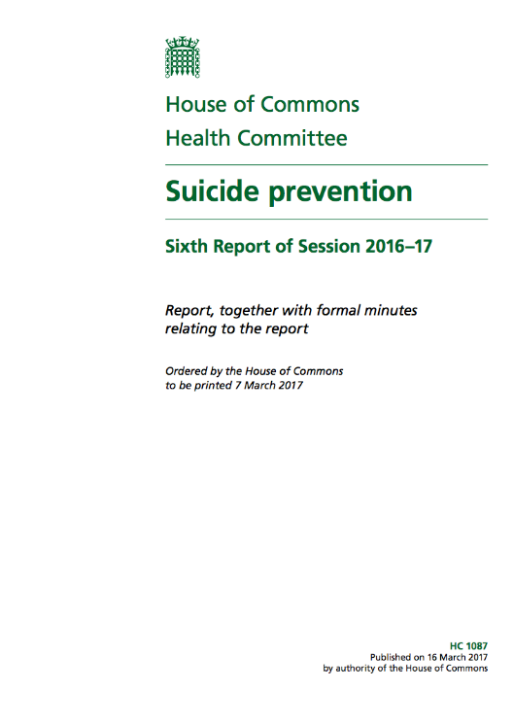
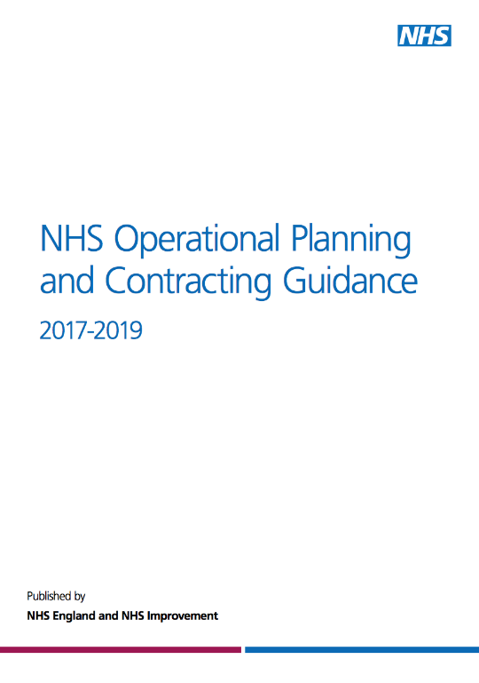
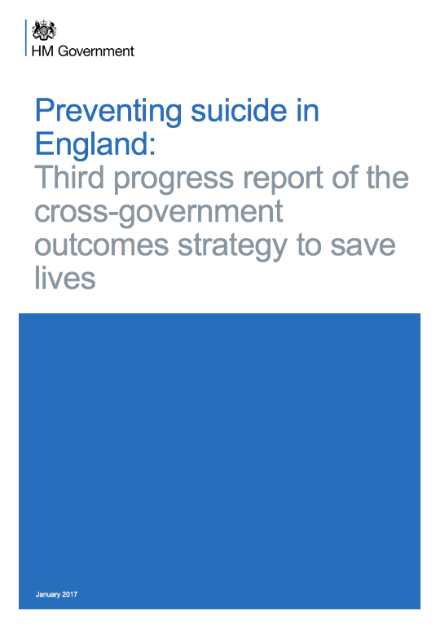
National policy context
Notes:
National policy provides the framework for local suicide prevention strategies and action plans.
There are also a range of wider public mental health and wellbeing policies targeting adults and children that are relevant and provide valuable opportunities for framing suicide prevention, and extends its reach. It is important to consider their implications and ensure that local suicide prevention strategies complement and capitalise on other programme areas that will have their own associated strategies, action plans and allocated resources.
The key national policies and documentation to be aware of, and to consider include:
National suicide prevention strategy (2012). This provides a comprehensive framework for identifying and shaping local priorities.
Preventing suicide in England: third progress report (January 2017). This includes a call for a renewed focus and action around five areas.
House of Commons Health Committee: Suicide prevention (March 2017). This outlines key areas for consideration by the Government.
Government response to the Health Select Committee’s Inquiry into Suicide Prevention (July 2017)
Five year forward view for mental health (Feb 2016). This report of an independent task force sets the target to reduce suicides by 10% nationally by 2021.
All-Party Parliamentary Group on Suicide and Self-harm Prevention report on the future of local suicide prevention plans (January 2015). This report includes findings from a survey of 150 of the 152 local authorities and demonstrates variation in local implementation of the national strategy.
NICE guidelines. Various guidelines can inform evidence-based practice.
It is important to also consider wider public mental health and wellbeing programmes targeting adults and children, for example:
No health without mental health (2011)
NHS Operating planning and contracting guidance
Outcomes frameworks (2015-2016)
Future in mind (2015)
Local transformation plans for children and young people’s mental health and wellbeing (2015)
Mental health crisis care concordat
Sustainability and transformation plans

Slide 7
Section 2
Ten essential things to know
about suicide prevention
Notes:
This section provides the top level messages around suicide prevention to communicate with Directors of Public Health, local authority leaders, chief executives and other senior officers and councillors.
Slides 8-9 provide the 10 messages in summary form.
Slides 10 – 19 explain each of the 10 messages per slide.

Slide 8
Suicide prevention: Ten essential things to know
1. | Suicides take a high toll
2. | There are specific groups of people at higher risk of suicide
3. | There are specific factors that increase the risk of suicide
4. | Preventing suicide is achievable
5. | Suicide is everybody’s business
Notes:
1. There were 4,575 deaths from suicide registered in England in 2016 and for every person who dies at least 10 people are directly affected.
2. Three in four deaths by suicide are by men. The highest suicide rate in England is among men aged 45-49. People in the lowest socio-economic group and living in the most deprived geographical areas are 10 times more at risk of suicide than those in the highest socio-economic group living in the most affluent areas.
3. The strongest identified predictor of suicide is previous episodes of self-harm. Mental ill-health and substance misuse also contribute to many suicides. Suicide prevention strategies must consider and link to programmes of early identification and effective management of self-harm, mental ill-health and substance misuse.
4. The delivery of a comprehensive strategy is effective in reducing deaths by suicide through combining a range of integrated interventions that build community resilience and target groups of people at heightened risk of suicide. Directors of public health and health and wellbeing boards have a central role. Their involvement is crucial in co-ordinating local suicide prevention efforts and making sure every area has a strategy in place.
5. A whole system approach is required, with local government, primary care, health and criminal justice services, voluntary organisations and local people affected by suicide having a role to play. Suicide prevention can also be part of work addressing the wider determinants of health and wellbeing.

Slide 9
Suicide prevention: Ten essential things to know
6. | Restricting access to the means for suicide works
7. | Supporting people bereaved by suicide is an important component of suicide prevention strategies
8. | Responsible media reporting is critical
9. | The social and economic cost to suicide is substantial and adds to the case for suicide prevention work
10. | Local suicide prevention strategies must be informed by evidence
Notes:
6. This is one of the most evidenced aspects of suicide prevention and can include physical restrictions, as well as improving opportunities for intervention.
7. Compared with people bereaved through other causes, individuals bereaved by suicide have an increased risk of suicide and suicidal ideation, depression, psychiatric admission as well as poor social functioning.
8. Research shows that inappropriate reporting of suicide may lead to imitative or 'copycat' behaviour.
9. The economic cost of each death by suicide of someone of working age is estimated to be £1.67 million. This covers the direct costs of care, indirect costs relating to loss of productivity and earnings, and the intangible costs associated with pain, grief and suffering.
10. Local government should consider the national evidence alongside local data and information to ensure local needs are addressed.

Slide 10
Suicide prevention: Ten essential things to know
1. Huge impact
2. Risk varies
3. Many contributing factors
4. Preventable
5. Everybody’s business
6. Restrict access to means
7. Support the bereaved
8. Report responsibly
9. High social and economic cost
10. Use evidence
Notes:
1. There were 4,575 deaths from suicide registered in England in 2016 and for every person who dies at least 10 people are directly affected.
2. Three in four deaths by suicide are by men. The highest suicide rate in England is among men aged 45-49. People in the lowest socio-economic group and living in the most deprived geographical areas are 10 times more at risk of suicide than those in the highest socio-economic group living in the most affluent areas.
3. The strongest identified predictor of suicide is previous episodes of self-harm. Mental ill-health and substance misuse also contribute to many suicides. Suicide prevention strategies must consider and link to programmes of early identification and effective management of self-harm, mental ill-health and substance misuse.
4. The delivery of a comprehensive strategy is effective in reducing deaths by suicide through combining a range of integrated interventions that build community resilience and target groups of people at heightened risk of suicide. Directors of public health and health and wellbeing boards have a central role. Their involvement is crucial in co-ordinating local suicide prevention efforts and making sure every area has a strategy in place.
5. A whole system approach is required, with local government, primary care, health and criminal justice services, voluntary organisations and local people affected by suicide having a role to play. Suicide prevention can also be part of work addressing the wider determinants of health and wellbeing.
6. This is one of the most evidenced aspects of suicide prevention and can include physical restrictions, as well as improving opportunities for intervention.
7. Compared with people bereaved through other causes, individuals bereaved by suicide have an increased risk of suicide and suicidal ideation, depression, psychiatric admission as well as poor social functioning.
8. Research shows that inappropriate reporting of suicide may lead to imitative or 'copycat' behaviour.
9. The economic cost of each death by suicide of someone of working age is estimated to be £1.67 million. This covers the direct costs of care, indirect costs relating to loss of productivity and earnings, and the intangible costs associated with pain, grief and suffering.
10. Local government should consider the national evidence alongside local data and information to ensure local needs are addressed.

Slide 11
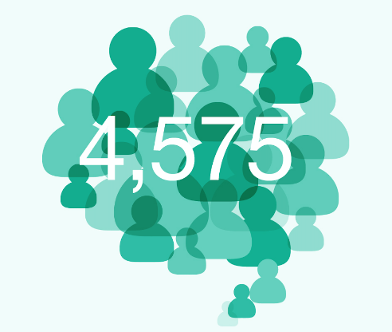
Suicides take a high toll
The impact of suicide is far-reaching and it remains with family, friends, colleagues and many others long after the individual has gone. The bereavement is often detrimental to performance at work, personal relationships, behaviour and wellbeing.
Anj Handa bereaved friend
Death by suicide in England in 2016
A conservative estimate of 10 people directly affected by each of these deaths gives a minimum total of almost 50,000 people annually who could benefit from support after suicide
Notes:
There were 4,575 deaths from suicide registered in England in 2016.
A conservative estimate of 10 people directly affected by each of these deaths gives a minimum of almost 50,000 people annually who could benefit from support after suicide.

Slide 12
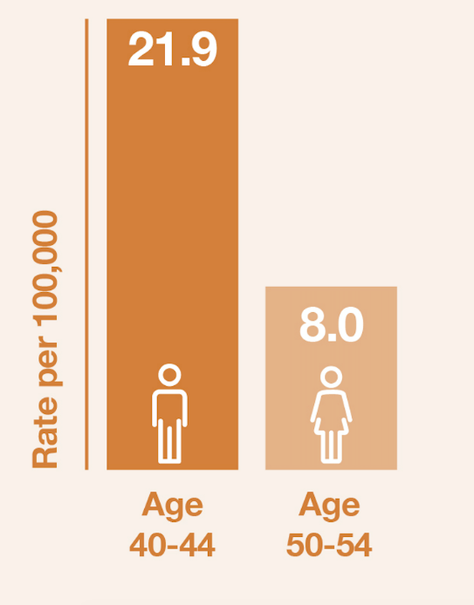
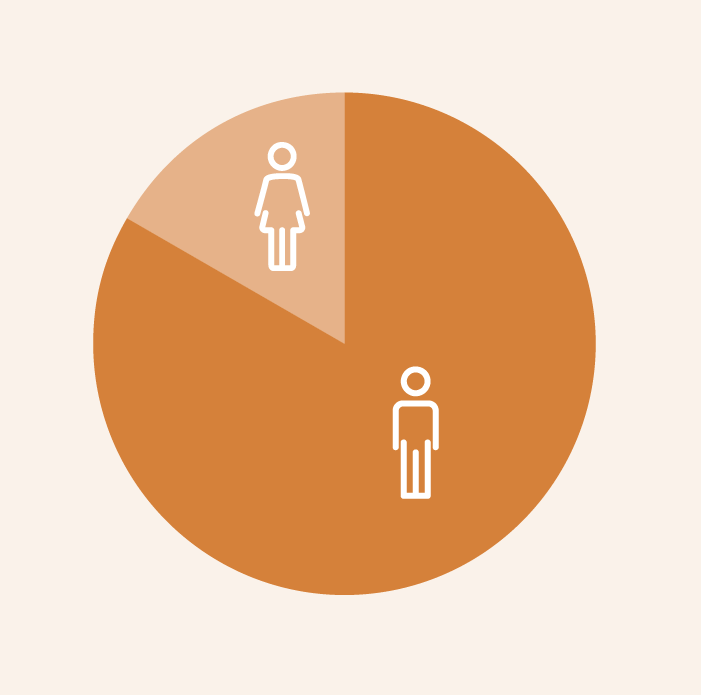
There are specific groups of people at higher risk of suicide
Gender: 75% of suicides are by men
Age: highest rate is 40-44 yr old men
Social-economic status: people living in the most deprived areas are ten times more at risk of suicide than those in the most affluent groups living in the most affluent areas
Notes:
Gender. Three in four deaths by suicide are by men.
Age. The highest suicide rate in England is among men aged 40 - 44.
Socio-economic group. People in the lowest socio-economic group and living in the most deprived geographical areas are 10 times more at risk of suicide than those in the highest socio-economic group living in the most affluent areas.

Slide 13
There are specific factors that increase the risk of suicide
Mental ill-health:
1 in 3 Around 1 in 3 people who die by suicide are known to mental health services
Occupation: Men in lowest skilled occupations had a 44% higher risk of suicide and men and women who are managers, directors and senior officials have a 70% lower risk
Self-harm: 50% of people who die by suicide had a history of self-harm
Notes:
Whilst self harm is the strongest identified predictor, the majority of people who self-harm don’t go on to take their own life – but it does suggest that more needs to be done in this area. Mental ill-health and substance misuse also contribute to many suicides. Suicide prevention strategies must consider and link to programmes of early identification and effective management of self-harm, mental ill-health and substance misuse.
Whilst 1 in 3 people who die by suicide are in contact with mental health services, this means that 2 out of 3 people aren’t. It is therefore critical that a public health approach is taken.

Slide 14
Suicide is everybody’s business
“Preventing suicide is a jigsaw, which requires many pieces to come together.”
Professor Jim McManus
Director of Public Health
Hertfordshire County Council
Notes:
Suicide is preventable and preventing suicide is achievable.
It requires a whole system approach, with local government, primary care, health and criminal justice services, voluntary organisations and local people affected by suicide having a role to play.
Suicide prevention needs to located across a wide range of strategies and should be part of work addressing the wider determinants of health and wellbeing.
The delivery of a comprehensive strategy is effective in reducing deaths by suicide through combining a range of integrated interventions that build community resilience and target groups of people at heightened risk of suicide. Directors of public health and health and wellbeing boards have a central role. Their involvement is crucial in co-ordinating local suicide prevention efforts and making sure every area has a strategy in place.

Slide 15
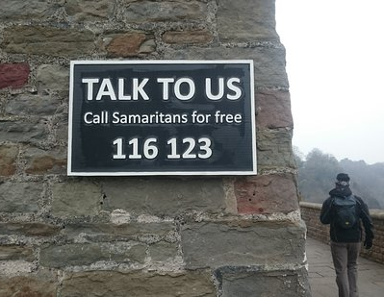
Restricting access to the means for suicide works
This is one of the most evidenced aspects of suicide prevention and can include physical restrictions, as well as improving opportunities for intervention.
Notes:
The evidence for restricting access to lethal means in prevention of suicide is ever strengthening, especially with regard to control of analgesics and structural interventions at high risk locations for suicide by jumping.
(Where these have been introduced there has been with an overall reduction in deaths of 86% and little evidence of major substitution to other potential jumping sites).
Restricting access can take the form of: • working with retailers to control the sale of dangerous gases and liquids
putting up barriers to restrict access
working with media to restrict coverage of methods and sites associated with suicidal acts. This has been linked with positive changes in media reporting as well as decreases in suicide levels.
The local data gathered from suicide audits or real-time surveillance can provide the valuable insights into emerging trends with regards to local locations and methods.
Public Health England has produced guidance on preventing suicide at high risk locations, such as bridges and high buildings. Preventing suicides in public places: a practice resource

Slide 16
Supporting people bereaved by suicide is an important component of suicide prevention strategies
Friends and relatives of people who die by suicide have a 1 in 10 risk of making a suicide attempt after their loss
People bereaved by suicide are 80% more likely to drop out of education or work than their peers, while 8% of young adults bereaved by suicide surveyed had dropped out of an educational course or a job since the death
Notes:
Compared with people bereaved through other causes, individuals bereaved by suicide have an increased risk of suicide and suicidal ideation, depression, psychiatric admission as well as poor social functioning.

Slide 17
Responsible media reporting is critical
Notes:
Research demonstrates strong links between media reporting of suicide and imitative suicidal behaviour.
This risk significantly increases if the suicide method is described, if the story is placed prominently and if the coverage is sensationalised and/or extensive.
While much of the work to promote responsible reporting is done at a national level, there is a place for prevention work with local media.
Local areas can make local journalists aware of, and help to ensure they follow the
Samaritans' guidance on responsible media reporting.
They can provide local media with access to the local designated suicide prevention lead so they can speak to them prior to running any story.
They can also encourage local media to provide information about sources of support and contact details of helplines when reporting mental health and suicide stories
Samaritans also offer an advisory service so if you see articles of concern locally or are concerned about a potential story then you can contact them for advice.

Slide 18
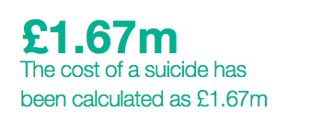
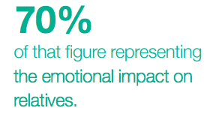
The social and economic cost to suicide is substantial and adds to the case for suicide prevention work
Notes:
The economic cost of each death by suicide of someone of working age is estimated to be £1.67 million. This covers the direct costs of care, indirect costs relating to loss of productivity and earnings, and the intangible costs associated with pain, grief and suffering.

Slide 19
Section 3
Understanding data

Slide 20
Using national and local data
National data:
ONS data
Public Health Outcomes Framework
PHE suicide prevention profile
Network Rail database
Local data:
Audit of coroner’s records
Data held by other partners such as primary care and employers
Real-time suicide surveillance
Notes:
Data offers the opportunity to gain important intelligence on the impact of suicide on particular populations and specific patterns and trends that may include:
Demographics and characteristics which may indicate high risk groups, such as those based on gender, age, ethnicity and/or sexual orientation
local context, such as particular high frequency locations or emerging methods
How patterns and trends are changing
Useful data and intelligence can come from a range of national and local sources, including:
ONS data
shows numbers and rates of death per 100,000 population.
rates are important as they account for the age and size of populations, so it is more reliable to use rates when comparing suicide across age groups and areas.
data available from 1981 to allow a review of changing trends.
figures are for deaths registered, rather than deaths occurring in each calendar year.
PHE suicide prevention profile tool
data on suicides by local authority, unitary authority and CCG.
collates a range of publicly available data on suicide, associated prevalence, risk factors and contact with health services among groups at increased risk
enables user to profile their area and benchmark against similar populations.
Rail industry database
The rail industry has a large database that can support local authorities investigate suicides on the rail network. suicidepreventionprogramme@networkrail.co.uk
There can be concerns about the strength of local data given that the numbers of suicides in a local authority geographical area tend to be small and the changes detected through monitoring over time even smaller. Sharing the work of data collection across a wider local authority footprint might help to mitigate this risk.
Collecting and analysing local data on the number of suicides, the context in which they occur, the groups most at risk and how the picture is changing over time is critical for effective suicide prevention work. Local intelligence informs the development of the suicide prevention strategy, provides an evidence base for action and the means to monitor and review progress.
Coroner’s records
By reviewing coroners’ records it is possible to gain a detailed retrospective insight into the circumstances of individual suicides. An audit ordinarily involves seeking the coroner’s approval to spend several days looking through the past year, 3 yrs or 5 yrs worth of records. Areas just starting out might focus on national data initially and build up to local data gathering.
Primary and secondary care data
To understand access to, uptake and performance of supporting services.
Other data could include:
local demographics, such as particular migrant populations and protected characteristics in particular those recognised as high risk groups on the basis of ethnicity and/or sexual orientation
local context, such as a local employer making a large number of people redundant
Local authorities are advised to focus on information that is not available using national data sources, and to think carefully about how they will use it to avoid the danger of gathering data with no clear purpose of link to suicide prevention strategy.
Real time suicide surveillance
This is a system that enables the public health team and/or the multi-agency suicide prevention group to consider and agree if a quick response is required to any potential emerging patterns that could indicate clusters, increasing trends or new methods of death, in advance of the coroners' conclusion.

Slide 21
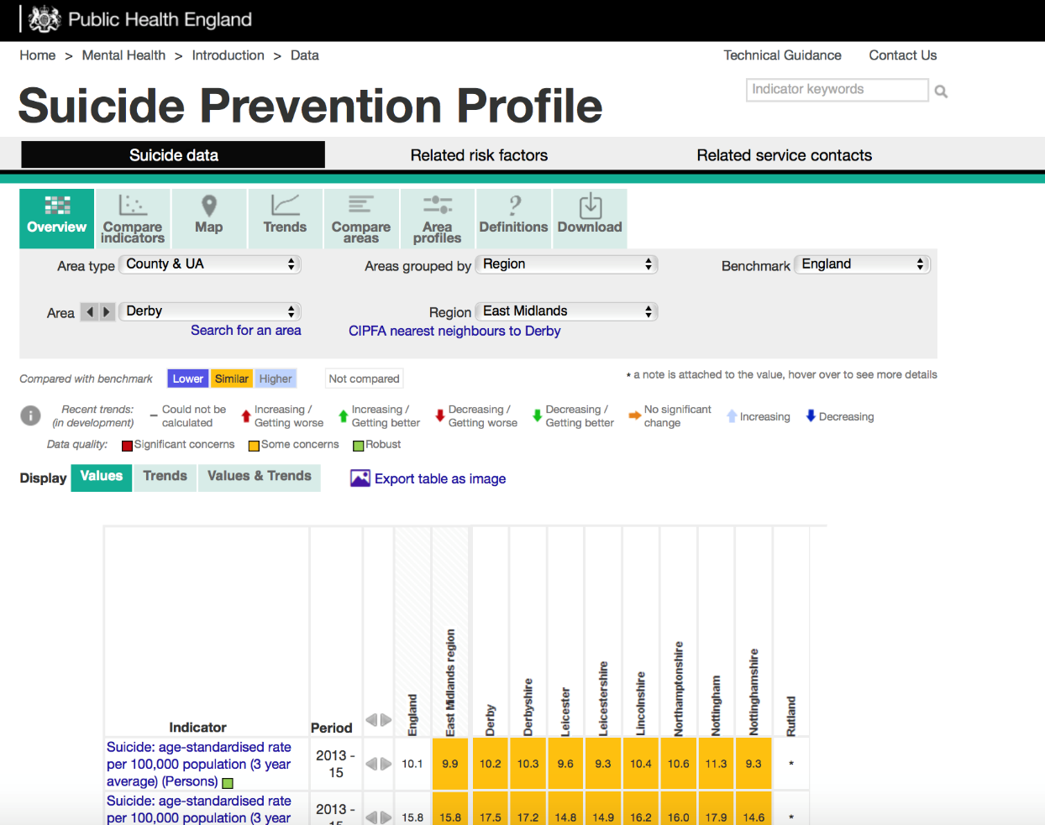
Suicide prevention profile
Notes:
The Public Health England Suicide Prevention Profile is a valuable resource for supporting local areas to understand what is happening locally to them. The tool can be accessed at: https://fingertips.phe.org.uk/profile-group/mental-health/profile/suicide
It collates and presents a range of publically available data on suicide, associated prevalence, risk factors, and service contact among groups at increased risk. It provides planners, providers and stakeholders with the means to profile their area and benchmark against similar populations.
The data is presented under the domains:
Suicide data
Related risk factors
Related service contacts
The data is grouped by CCG or local authority area and then within that there are different topics organised around primary care services, specialist care and emergency care.
The data are drawn from a number of sources and vary by time period and presentation of value. Some values are based on small numbers. Care should be taken with interpretation.. Each indicator has been assessed and labelled with its quality rank.

Slide 22
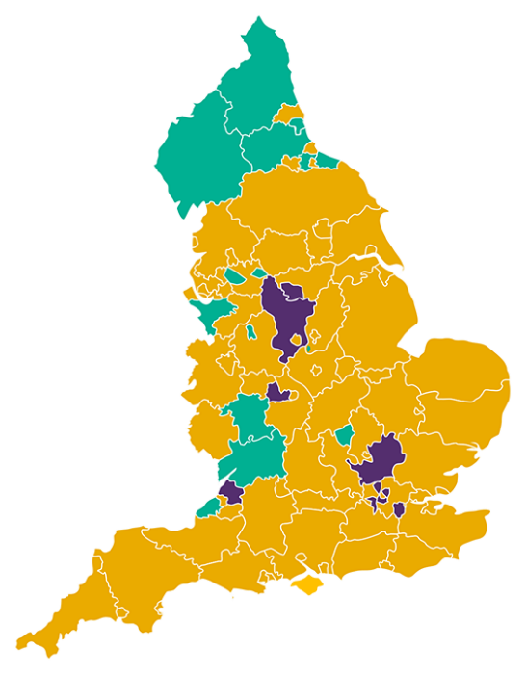
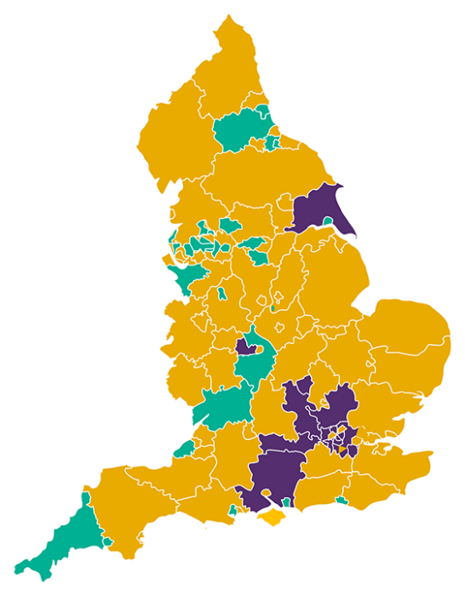
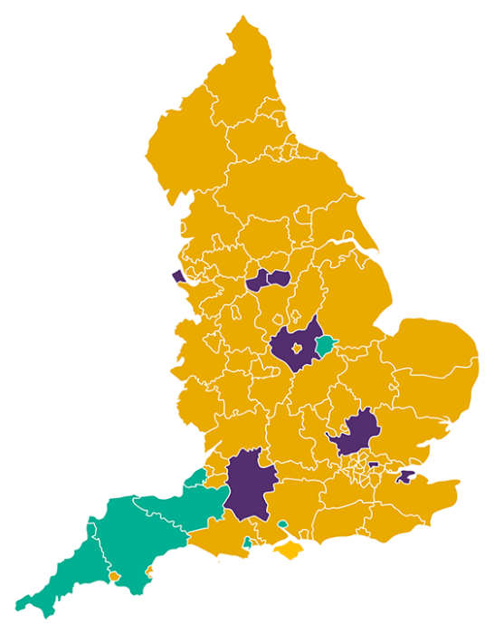
Suicide prevention profile
These maps from the Suicide Prevention Profile indicate the local and regional variations in the male suicide age-standard rate per 100,000.
15-34 year olds
34-64 year olds
65+ year olds
Higher
Similar
Lower
Notes:
The Suicide Prevention Profile (https://fingertips.phe.org.uk/profile-group/mental-health/profile/suicide) can be used to examine differences in, for example, the male or female suicide crude rate per 100,000, or the age-standardised rate.
These maps shows the male rate across different areas of England for three different age groups, 15-34 years, 35-64 years and 65+ years as benchmarked against the rate for England.
The purple indicates lower rates than the England average, with orange indicating similar and green for higher rates. This demonstrates variations in suicide rates across the country with the highest rates of suicide in men found in the North among 15-34 year olds, local and regional differences for 35-64 year olds and in the South West for over 65 year olds.
The Suicide Prevention Profile can also be used to examine the suicide age-standardised rate per 100,000 (3 year average) on the basis of deprivation and enable comparisons with statistical neighbours.
It can help to illustrate the importance of being aware of the particular demographics in any region, as well as the national averages.

Slide 23
Real time suicide surveillance
Systems that enable any death where circumstances suggest suicide to be considered in advance of inquest conclusion
Two potential models:
Led by coroner
Led by police, who often first responders on scene
Originally piloted in Durham/ Leicester/ South Yorkshire and now adopted in other areas
Notes:
Real-time suicide surveillance, also known as real time data, is a system that enables the public health team and/or the multi-agency suicide prevention group to consider and agree if a quick response is required to any potential emerging patterns that could indicate clusters, increasing trends or new methods of death, in advance of the coroners' conclusion.
The system can importantly also provide the means to offer timely support to people who have been bereaved or affected by a suspected suicide.
There are two potential models, one that is led by coroners, and one that is led by the police who are often the first responders at the scene of a death.
Some local areas have been exploring the benefits of these different models in order to gather earlier intelligence on suspected suicides that have taken place locally.
To be effective, either model of real-time surveillance requires the existence of a multi-agency partnership that can consider the real-time data in a timely way.
A system-wide response process is also needed that sets out the agreed trigger and protocol for escalating further action, what the actions will include and clear roles and responsibilities.
Further information about the two models are available in the local suicide prevention planning guidance.

Slide 24
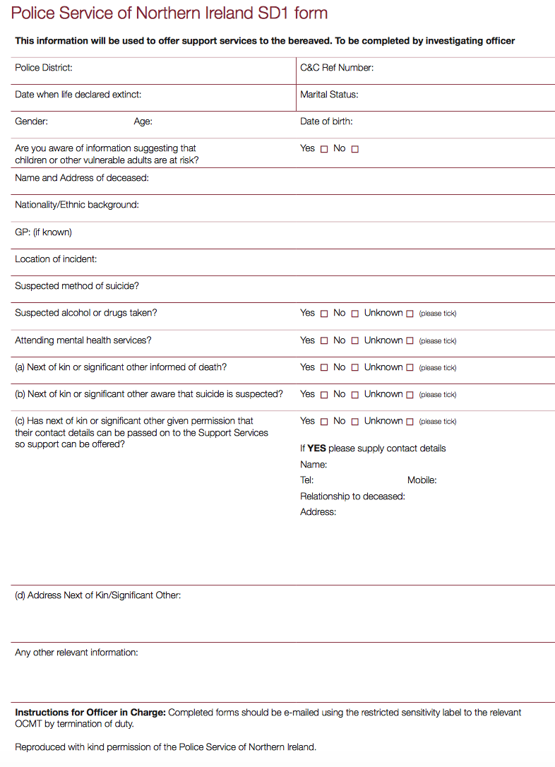
Real time suicide surveillance
Systems that enable any death where circumstances suggest suicide to be considered in advance of inquest conclusion
Two potential models:
Led by coroner
Led by police, who often first responders on scene
Originally piloted in Durham/ Leicester/ South Yorkshire and now adopted in other areas
Notes:
Real-time suicide surveillance, also known as real time data, is a system that enables the public health team and/or the multi-agency suicide prevention group to consider and agree if a quick response is required to any potential emerging patterns that could indicate clusters, increasing trends or new methods of death, in advance of the coroners' conclusion.
The system can importantly also provide the means to offer timely support to people who have been bereaved or affected by a suspected suicide.
There are two potential models, one that is led by coroners, and one that is led by the police who are often the first responders at the scene of a death.
Some local areas have been exploring the benefits of these different models in order to gather earlier intelligence on suspected suicides that have taken place locally.
To be effective, either model of real-time surveillance requires the existence of a multi-agency partnership that can consider the real-time data in a timely way.
A system-wide response process is also needed that sets out the agreed trigger and protocol for escalating further action, what the actions will include and clear roles and responsibilities.
Further information about the two models are available in the local suicide prevention planning guidance.

Slide 25
Section 4
Strategy and action
Notes:
Any approach to suicide prevention must be rooted in a recognition that people from all types of communities die by suicide, as a result of a wide and complex set of interrelated factors. As a result, suicide prevention requires work across a range of settings and targeting wide variety of audiences.
It’s therefore absolutely fundamental that any strategy seeks to combine the knowledge, expertise and resources of public, private and voluntary sector organisations working collectively. There is no single agency able to do it alone.

Slide 26
Importance of partnerships
A wide range of representatives working with adults, children and young people may be brought together to contribute to a multi-agency suicide prevention group
The group may be led by public health or an elected champion
There can also be a wider network that feeds in for specific projects or on specific topics
Schools, colleges & universities
Benefits Advisers
Social services
Armed forces
Drugs and alcohol services
Faith leaders
British Transport Police
Employers
Suicide Prevention Partnership
Network Rail
Public health
Housing associations
Emergency services
Careers’ organisations
Prisons and probation
Community & voluntary sector
Police & Crime Commissioners
CCG’s
Job Centre Plus
Coroner’s office
Primary care including
G P’s
Crisis Care Concordat network
Health
and care providers
Police
People affected by suicide
Notes:
The multi-agency suicide prevention group may be responsible for:
Understanding patterns of suicide and collate data
Steering development of strategy and action plan
Developing and coordinating responses to suicide and activities to reduce suicide
Making strategic links across the sector
Monitoring progress
Reporting to health and wellbeing board to influence commissioning decisions and secure funding
This group may then in turn be complemented by a suicide prevention network or partnership in which a wider range of representatives may engage at different levels or for specific projects, such as:
• community forums where partners can gather views from a wider network across the community and engage people in their work
• task and finish groups that oversee individual projects and areas of work
• suicide prevention champions who get involved in specific pieces of suicide prevention work – this might include people who have been bereaved by suicide or those with a special interest or expertise
• working with other organisations such as private sector companies, faith groups or education providers who bring specific skills, insights or access to at risk groups
• regional networks which share knowledge and resources, address broader issues and support collective action towards agreed targets
Every area will have different opportunities for partnership working. In areas where responsibility for health and social care is being devolved to a local level, such as in Greater Manchester or the West Midlands, there is scope for suicide prevention to form part of a wider health and wellbeing strategy and action plan. Elsewhere, there may be scope for co-operation across local authority boundaries.

Slide 27
Involving people with lived experience
Contribute a more complete picture of suicide and suicide prevention
Identify issues that clinicians and commissioners might not be aware of
Highlight gaps between policy and practice
Help to ensure work is grounded in the reality of the impact of suicide and self-harm
Notes:
Suicide prevention work can be greatly enhanced by engaging people who have personal experience of suicide – those who have been bereaved by suicide, have experienced suicidal ideation themselves or who are living with someone with suicidal ideation.
Involving people affected by suicide adds value to suicide prevention by:
• bringing personal experience to create a more complete picture of suicide and suicide prevention
• helping to identify issues that clinicians and commissioners might not be aware of
• highlighting gaps between policy and practice
• helping to ensure work is grounded in the reality of the impact of suicide and self-harm
The involvement of service users is also an established part of national and local government policy and practice with guidance available, for example Transforming participation in health and care.
More recently, an approach based on co-production has become more common in developing policy and services.

Slide 28
National Survivor User Network framework
Notes:
The National Survivor User Network has developed a framework for involving people with experience of mental health issues in policy and strategy development. This has been adopted by a number of local authorities, clinical commissioning groups and NHS trusts.

Slide 29
Strategy and action plan development
Statement of support from a local leader
Case for suicide prevention locally
Clearly stated ambition and objectives
Approach to monitoring and evaluating outcomes
Priority areas for action based on national strategy
Priority areas based on local data and needs
Links with other strategies including Prevention Concordat
Notes:
A local suicide prevention strategy usually covers at least a three-year period. It needs to set out clear objectives and provide a framework for the action plan.
It typically includes:
• a foreword from a stakeholder in a senior role, for example from the director of public health, an elected member or the chair of the health and wellbeing board
• the case for suicide prevention locally, including data and intelligence on high risk groups and/or risk factors
• a clearly stated ambition and objectives for what wants to be achieved
• the approach to monitoring and evaluating outcomes in order to determine progress
• priority areas for action based on the reinvigorated national strategy, in particular for middle-aged men, people who self harm and those bereaved by suicide
• priority areas for action based on local data and needs, such as interventions focused on particular high risk locations, where the evidence base for action is increasing
• links with other strategies, such as those for mental health and wellbeing
The action plan, detailing the specific activity that is going to be delivered, is often presented together with the strategy as one document, with the action plan updated annually.

Slide 30
Mapping to other agendas
Joint strategic needs assessment
Mental health and wellbeing strategies
Crisis care concordats
Sustainability and transformation plans
Children & young people’s services transformation plans
Commissioning of substance misuse services
Notes:
Suicide is a complex issue and prevention strategies need to recognise the importance of tackling factors that can lead to suicide in order to be most effective.
Suicide prevention activity can be incorporated into other strategies and programmes including:
• Joint strategic needs assessments
• Mental health and wellbeing strategies
• Local crisis care concordat action plans
• Sustainability and transformation plans
• Local transformation plans for children and young people's mental health and wellbeing
• Commissioning of alcohol and substance misuse services
It is recommended that local authorities map suicide prevention to the JSNA.

Slide 31
Making the case
Notes:
It is recommended that the strategy includes a case for action setting out the rationale for why suicide prevention is required in the local area. Locally available data and intelligence can be presented alongside nationally available data, and insights from the existing evidence and policy base can be highlighted.
There is a range of information that could include:
• the reasons people take their own lives, including intelligence and data about local factors
• the public health profile, including any particular populations at risk of suicide
• the financial and human cost of suicide and the cost effectiveness of suicide prevention
• the national policy context for local action
• the potential return on investment
It some areas, such as Suffolk (pictured here) and in Lambeth the case has also been visually illustrated to tell an impactful story at a glance.
A note about the potential return on investment
The economic cost of each death by suicide in England for those of working age is estimated to be £1.67 million (2009 prices). This covers the direct costs of care, indirect costs relating to loss of productivity and earnings, and the intangible costs associated with pain, grief and suffering.
A business case for suicide prevention may include broad estimates of the cost of suicide. Calculations may include multiplying the number of suicides in a particular area by an estimated cost of one suicide. However, care must be taken with these estimates.
One European study found "that if an area wide suicide prevention intervention were to achieve only a modest 1% reduction rate in the number of suicides, in most scenarios this remains highly cost-effective.”
The Local Government Association and The King’s Fund demonstrate how facts around return on investment in public health can be set out.

Slide 32
Making the case
Reasons people take their own lives, including intelligence and data about local factors
Public health profile, including any particular populations at risk of suicide
Financial and human cost of suicide and the cost effectiveness of suicide prevention
National policy context for local action
Potential return on investment
Notes:
It is recommended that the strategy includes a case for action setting out the rationale for why suicide prevention is required in the local area. Locally available data and intelligence can be presented alongside nationally available data, and insights from the existing evidence and policy base can be highlighted.
There is a range of information that could include:
• the reasons people take their own lives, including intelligence and data about local factors
• the public health profile, including any particular populations at risk of suicide
• the financial and human cost of suicide and the cost effectiveness of suicide prevention
• the national policy context for local action
• the potential return on investment
A note about the potential return on investment
The economic cost of each death by suicide in England for those of working age is estimated to be £1.67 million (2009 prices). This covers the direct costs of care, indirect costs relating to loss of productivity and earnings, and the intangible costs associated with pain, grief and suffering.
A business case for suicide prevention may include broad estimates of the cost of suicide. Calculations may include multiplying the number of suicides in a particular area by an estimated cost of one suicide. However, care must be taken with these estimates.
One European study found "that if an area wide suicide prevention intervention were to achieve only a modest 1% reduction rate in the number of suicides, in most scenarios this remains highly cost-effective.”
The Local Government Association and The King’s Fund demonstrate how facts around return on investment in public health can be set out.

Slide 33
Accountability
Should lie with the Health & Wellbeing Board
Provide crucial influence and support for successful implementation
Other lines of accountability may include Safeguarding Adults Board and Children & Families Partnership Board
Regional collaboratives require accountability mechanism e.g. strategic partnership board
Notes:
Accountability for the suicide prevention strategy and its associated action plan lies locally with the health and wellbeing board, as the body with responsibility for overseeing the planning of health services in the area.
These boards can provide crucial influence and impetus to support the design and delivery of a suicide prevention strategy and enable it to be adopted under the wider health and wellbeing strategy.
Regional collaboratives, need accountability mechanisms for the regional element of any strategy, alongside local requirements, such as reporting back to their health and wellbeing board.
One mechanism for this wider accountability could be to create a strategic partnership board, with local groups feeding into this central board.

Slide 34
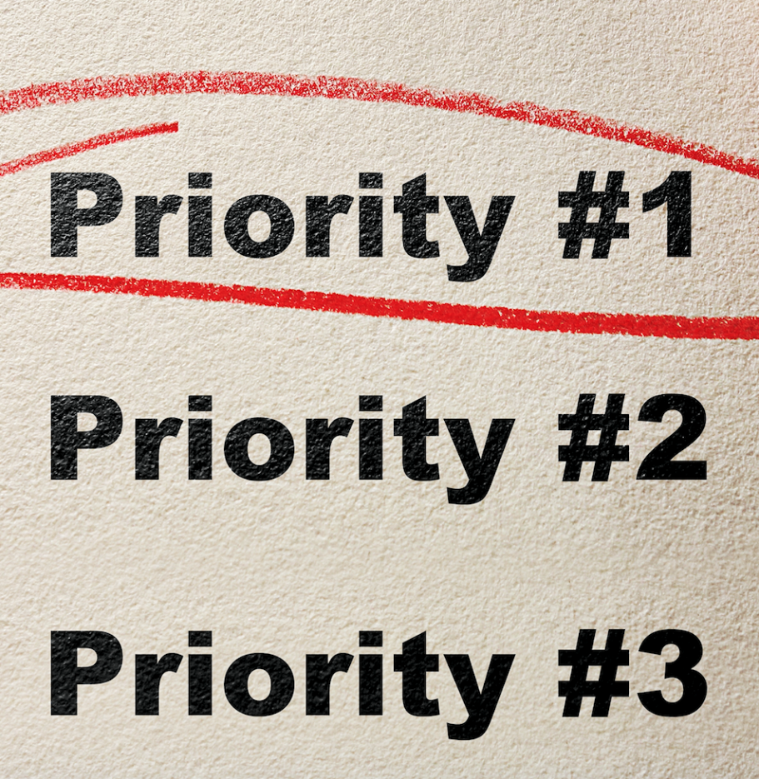
Priority areas for local strategies
National strategy provides a ready-made framework
Priorities should be informed by evidence from national and local data
Begin with small number of areas for immediate action and build over time
‘Refreshed’ strategy reaffirms key priorities including self-harm and suicide bereavement
Notes:
Many local strategies align with the National Strategy Areas for Action and it’s recommended all areas aim to cover these strategy areas in the long-term.
Six areas for action in the national strategy that all areas should aim to address in their local strategy in the long-term:
1. reduce the risk of suicide in key high-risk groups
2. tailor approaches to improve mental health in specific groups
3. reduce access to the means of suicide
4. provide better information and support to those bereaved or affected by suicide
5. support the media in delivering sensitive approaches to suicide and suicidal behaviour
6. support research, data collection and monitoring
Some strategies and supporting action plans have chosen to concentrate on three or four areas for action where local partners believe they can make the most difference in their area.
Where local prevention strategies span across all six of the areas this is often as a result of work that has developed over a long period of time.

Slide 35
Priorities: by Professor Louis Appleby (Leads the National Suicide Prevention Strategy for England)
1. Reducing risk in men
2. Preventing and responding to self-harm
3. Mental health of children and young people
4. Treatment of depression in primary care
5. Acute mental health care
6. Tackling high frequency locations
7. Reducing isolation
8. Bereavement support
Notes:
In the long term local areas should aim to tackle all six areas of the national strategy.
Professor Louis Appleby has identified that in the short term there are eight recommended priorities for a co-ordinated whole system approach.
(Professor Appleby leads the National Suicide Prevention Strategy for England and is Professor of Psychiatry at the University of Manchester and Director of the National Confidential Inquiry into Suicide and Homicide by People with Mental Illness).
Reducing risk in men, especially in middle age, with a focus on: economic factors such as debt; social isolation; drugs and alcohol; developing treatment and support settings that men are prepared to use
Preventing and responding to self-harm, with a range of services for adults and young people in crisis, and psychosocial assessment for self-harm patients
Mental health of children and young people, with joint working between health & social care, schools & youth justice, and plans to address the drastic increase in suicide risk between 15 to 19 year olds
Treatment of depression in primary care, with safe prescribing of painkillers & antidepressants
Acute mental health care, with safer wards & safer hospital discharge, adequate bed numbers & no out of area admissions
Tackling high frequency locations, including working with local media to prevent imitative suicides
7. Reducing isolation, for example through community-based supports, transport links and working with third sector
8. Bereavement support, especially for people bereaved by suicide
Over the long term, local areas should aim to tackle all six areas of the national strategy.

Slide 36
Monitoring and evaluation
Be clear from the outset how effectiveness and impact will be measured
Set outcome measures, ultimately this is a reduction in suicides but should not be the only outcome measure:
Suicide attempts and self-harm
Help-seeking
Engagement with services
Perceived reduction in stigma
Notes:
The ultimate aspiration is to see a reduction in the number of suicides and the Five year forward view for mental health set the ambition that by 2020/21 the number of people taking their own lives will be reduced by 10% nationally compared to 2016/17 levels.
Contributing to this is a fundamental outcome for all areas, regardless of whether the local rate is currently comparatively high or low.
The relatively small number of suicides at a local level can make it difficult to measure a significant change in rates.
The World Health Organization has said that because suicide is a relatively rare phenomenon, reductions in mortality should not be the only outcome measure for a suicide reduction programme.
This could include collecting the views and experiences of professionals and people who are involved with community-based suicide prevention interventions and their families and carers. For example, the extent to which they believe there is less stigma attached to suicidal thoughts.
Given evidence that shows the importance of depression recognition and treatment for depression, outcomes measures such as referral rates, psychiatric treatment rates and changes in mental health state as assessed by validated measures, could be considered.
There is also growing evidence to support using self-harm as an outcome measure for suicide prevention work with evidence showing that hospital presentation following self-harm is a clear risk factor for suicide.
Other measures for self-harm include the extent to which patients presenting at hospital receive assessment following self-harm in line with NICE guidelines, to enable early identification and treatment of alcohol problems, and the number of people presenting with self-harm who go on to receive cognitive behavioural therapy.

Slide 37
Section 5
Ideas and resources:
People bereaved by suicide
Occupation
Notes:
It’s important to remember that there is no one magic bullet, and ‘one size does not fit all’. Most effective action plans reflect the evidence of local need and will need to vary to suit local circumstances, as well as available resources.
The local suicide prevention planning resource includes some ideas for action. But, it is not intended to be exhaustive or prescriptive.
It is likely that most local action plans will focus on having activity to address the six priorities set out in the government strategy.
Two particular areas have been pulled out here:
People bereaved by suicide
Suicide by occupational groups

Slide 38
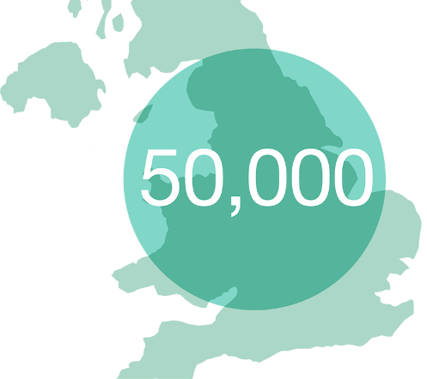
People bereaved by suicide
Postvention
Describes activities developed by, with, or for people who have been bereaved by suicide, to support their recovery and to prevent adverse outcomes, including suicide and suicidal ideation.
Around 50,000 people are directly affected by each suicide.
The cost of a suicide has been calculated as £1.67m
70%
of that figure representing the emotional impact on relatives
Notes:
The fourth priority area in the national strategy is providing information and support to those bereaved or affected by suicide. There is growing evidence that individuals and communities feel the need for support following suicides.
Pending trial evidence, there is also the hope that this support might serve to reduce the risk of the adverse consequences of suicide bereavement, which include poor social and occupational functioning, depression, suicide attempt, and even suicide.
It is important that all geographical areas include a comprehensive postvention component to the suicide prevention strategy in order to ensure that there is timely information and support provided to those bereaved or affected by a suicide, as well as the means to deliver a rapid community-based response if there is an emerging cluster.
There should also be resources made available to support those who are concerned about a family member, friend of colleague.
These area of work is increasingly been known as postvention. It is a key element of an integrated suicide prevention approach.
Those bereaved by a suicide are:
At increased risk of mental health and emotional problems
Experience may affect ability to cope with everyday activities such as work, relationships and social functioning
Higher risk of suicide
The cost of a suicide has been calculated as £1.67m, with 70% of that figure representing the emotional impact on relatives. Although we do not yet have estimates for the effect that postvention programmes could have on social functioning, stigma, mental health, physical health and mortality in England, existing evidence suggests the potential for significant health and economic benefits.
The wide-reaching impact of each suicide means that being bereaved or affected by suicide is not an uncommon experience. 4,575 people died by suicide in England in 2016. Estimates vary on how many people are affected by each suicide – ranging from 6 to 60 people. A conservative estimate of 10 people directly affected by each of these deaths gives a minimum total of almost 50,000 people annually who could benefit from support after suicide.

Slide 39
Suicide postvention: Ten essential things to know
1. | Postvention is an essential part of public health
2. | The scale of the problem
3. | Suicide affects a wide range of people
4. | There is significant unmet need for support
5. | The health and economic case for action is building
Notes:
1. When compared with people bereaved through other causes, those bereaved by suicide are at an increased risk of suicide, psychiatric admission and depression. Bereavement through suicide is also more likely to result in suicide attempt and poor social functioning, with people who have been bereaved by suicide reporting that the experience affected their ability to cope with everyday activities such as work, relationships and social functioning.
2. The wide-reaching impact of each suicide means that being bereaved or affected by suicide is not an uncommon experience. 4,820 people died by suicide in England in 2015. Estimates vary on how many people are affected by each suicide – ranging from 6 to 60 people. A conservative estimate of 10 people directly affected by each of these deaths gives a minimum total of almost 50,000 people annually who could benefit from support after suicide.
3. Close family members, particularly parents and spouses or partners, are thought to be most vulnerable groups following a suicide, but there are also risks for wider family, friends and colleagues. The number of people affected is concerning given the recognised potential for suicide contagion – where a suicide influences suicidal ideation in others – particularly among young people. Support after a suicide should be available to people throughout the deceased individual’s social network, as well as to health professionals and others affected by the suicide.
4. Research suggests there is a substantial unmet need for support and it is important that all are aware of the range of resources and services available. Survey data suggests that two thirds of people in the UK bereaved by suicide receive no formal support from health or mental health services, the voluntary sector, employers or education providers. The stigma of suicide is a known barrier to bereaved family members seeking help, as well as to others offering support
5. The cost of a suicide has been calculated as £1.67m, with 70% of that figure representing the emotional impact on relatives. Although we do not yet have estimates for the effect that postvention programmes could have on social functioning, stigma, mental health, physical health and mortality in England, existing evidence suggests the potential for health and economic benefits.

Slide 40
Suicide postvention: Ten essential things to know
6. | Postvention supports work on wider social issues
7. | People want different types of support
8. | We can learn from what others are doing
9. | Local postvention programmes rely on strong partnerships
10. | Evaluation of outcomes is important
Notes:
6. Supporting people who have been bereaved by suicide helps to promote social inclusion, reduce health inequalities and keep people in education and employment. Postvention programmes have the potential to address known links between suicide bereavement and social isolation, increased physical and mental ill health, and difficulties with meeting work or study commitments.
7. Many people bereaved by suicide express the need for immediate outreach from a range of voluntary and statutory sector support services, along with a clear overview of what is available and access to group and individual counselling. The type of support and how long it will be needed for varies from person to person. The time point at which individuals decide to seek help differs too – it could be right away, several months after their bereavement, or further down the line, around significant anniversaries or family events.
8. Australia and the US have well established programmes for suicide bereavement support and the range of support available in the UK has grown in recent years. Different models of support include local suicide bereavement support groups, one-to-one and family support, online resources and telephone helplines, and opportunities for individual and group counselling or psychotherapy. Evidence based training has also been developed to guide GPs and mental health professionals to support parents bereaved by suicide.
9. Postvention should form a key part of local suicide prevention strategies and action plans, and involve close collaboration between commissioners, coroners, police, health and mental health services and organisations providing support services. Effective partnership working enables local teams to act quickly following a possible suicide and provide timely support to families and communities.
10. Building evaluation into postvention support is essential for demonstrating effectiveness and value for money. An evaluation framework to guide the systematic collection and analysis of information supports service development and provides thorough monitoring of activities, ensuring good governance. Evaluation enables people delivering services to understand the needs of their clients and to improve the support that they provide.

Slide 41
Specific actions for postvention
Effective and timely emotional and practical support, to help the grieving process and support recovery
Effective responses to the aftermath of a suicide
Information and support for families, friends and colleagues who are concerned about someone who may be at risk of suicide
Notes:
Key actions that should be addressed include:
• ensure all first responders have supplies of, and distribute, the Help is at Hand z-card
• disseminate the Help is at Hand booklet to affected individuals via Coroner’s office, local funeral directors and voluntary sector organisations
• provide Help is at Hand in community settings such as libraries, primary care and community centres and through bereavement support organisations
• map current provision of bereavement support services to identify gaps to address through commissioning
• support community-response in settings such as schools, colleges and workplaces
• ensure individual approaches for anyone identified as being at risk of contagion, including rapid referral for community mental health support where needed

Slide 42
Resource for people bereaved by suicide
Notes:
Help is at Hand provides people affected by suicide with both emotional and practical support.
People who have been bereaved by suicide have used their experiences to lead the revision of this support guide to help others affected by someone taking their own life.
It includes first person stories.
It is available online at http://supportaftersuicide.org.uk/support-guides/help-is-at-hand/

Slide 43
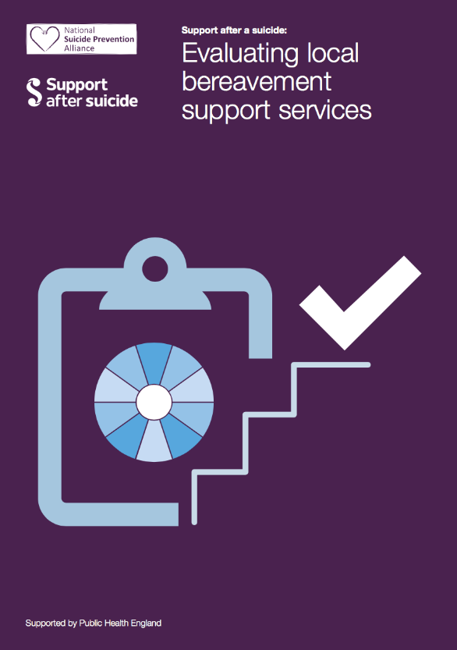
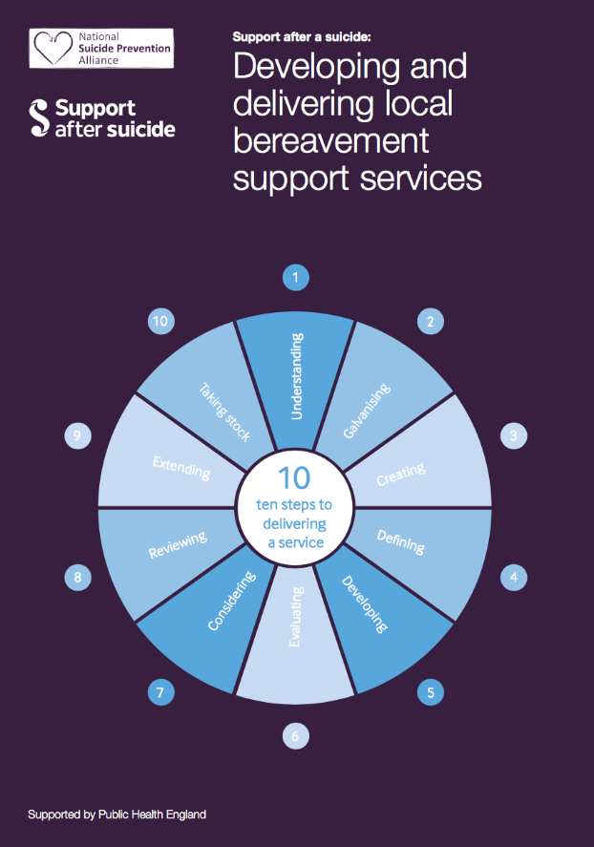
Resources on postvention services
Notes:
A guide to providing local services provides guidance on commissioning and delivering support after
a suicide (otherwise known as postvention support), as part of a wider suicide
prevention strategy.
It is designed to help commissioners, health and wellbeing boards, and others understand why
postvention should be a part of local suicide prevention work and how others are delivering
postvention support. It summarises what we know about how suicide affects individuals, families and
communities, and their expressed needs for locally developed and delivered support.
As well as providing an overview of the evidence, it includes some ideas for action. It is not intended to be exhaustive
This resource is complemented by two NSPA resources:
Developing and delivering local suicide postvention support, which draws on the experience of existing services that have been developed by, with, or for people bereaved by suicide, to support their recovery and to prevent adverse outcomes, to outline an approach to providing appropriate services.
Evaluating local suicide postvention support which provides a suggested framework by which services can be set up, monitored and evaluated.

Slide 44
Suicide by occupation
Men in lowest skilled occupations had a 44% higher risk of suicide
Men in skilled trades had a 35% higher risk
Managers, directors and senior officials 70% lower for both sexes
Notes:
ONS were commissioned by PHE to update their previous work on Patterns of Suicide by Occupation in England and Wales 2001-2005. The analysis is based on deaths recorded as suicide from death registrations in England between 2011 and 2015 among males and females aged 20 to 64 years. Suicide was defined using the National Statistics definition of suicide which includes deaths given as an underlying cause of intentional self-harm or injury/poisoning of undetermined intent. While it is likely that the occupation recorded on the death certificate reflects the deceased’s main lifetime occupation, it could also be the case that the deceased was retired, unemployed or in a different profession altogether at the time of death.
There were 18,998 suicides in men and women aged between 20 and 64 between 2011 and 2015 which is a rate of around 12 deaths for every 100,000 people per year. For around 7 in 10 (13,232) of these suicides an occupation was coded.
Males working in the lowest skilled occupations had a 44% higher risk of suicide than the national average; the risk among males in skilled trades was 35% higher.
Low skilled male labourers, particularly those working in construction roles, had a three times higher risk of suicide than the national average.
Of the skilled trades, the highest risk of suicide was among building finishing trades. Particularly, plasterers and painters and decorators had more than double the risk of suicide than the national average.
For males (20% higher than male average) and females (69% higher) the risk of suicides was elevated for those in culture, media and sport occupations. Risk was highest among performers, musicians and entertainers.
For females, the risk of suicide among health professionals was 23% higher than the national average. This is largely explained by high suicide risk among female nurses.
Male and female carers had a risk of suicide that was approximately twice the national average.
Females within the teaching and education profession had a lower than expected risk of suicide but specifically for primary and nursery school teachers there was evidence of an elevated risk.
Individuals working in roles as managers, directors and senior officials - the highest paid occupation group - had the lowest risk of suicide. Among corporate managers and directors the risk of suicide was more than 70% lower for both sexes.

Slide 45
Why are these occupations at risk?
The analysis does not provide any evidence on causation
However, there are three broad reasons why an occupation may carry a high risk of suicide:
people at higher risk selectively go into it, for example socio-economic determinants
something about the occupation adds to risk – job-related conditions
access to means - people in it have access to, or knowledge of, a suicide method that is more likely to be fatal.
Notes:
(On 1) Suicide is a significant inequality issue as there are marked differences in suicide rates according to people’s social and economic background. Those in lower skills occupations, particularly construction, are significantly at risk compared to managers, directors and senior officials and it may be that some of this risk is being brought into the workplace. This emphasises the importance of our wider work on inequalities. It also highlights the opportunity to reach people who may already be at risk to get support through the workplace.
(On 2) This links in with PHE’s work to ensure psychologically safe workplaces. The fact that lower skill occupations are higher risk than higher skilled occupations may also point to the importance of the HSE Stress Management Standards, particularly in relation to control and autonomy. Our suicide prevention toolkit points to the importance of this.
(On 3) This relates to access to means. Our suicide prevention toolkit provides advice on this. Self-poisoning was the most likely method of suicide among female health professionals, explaining 41.2% of all suicides. This shows that this is likely a factor for this group.

Slide 46
Resources for employers
Notes:
Free online resources on suicide prevention and postvention for employers
Relevant to all employers, irrespective of size, sector
Key tools:
PHE BITC Samaritans Reducing the risk of suicide: a preventative toolkit for employers provides support on how to recognise symptoms and prevent suicide
PHE BITC Samaritans Crisis management in the event of a suicide: a postvention toolkit for employers offers practical advice for employers to follow in the aftermath of an employee suicide
They are designed to help employers take positive actions to build a culture that champions good mental and physical health and provide a greater understanding of how to help those who need more support. For larger organisations, the toolkits are also useful resources to share with businesses in their supply chain and across their network.
Every organisation has an opportunity to support and develop a healthy workforce and it doesn’t need to be complicated – these toolkits help organisations to understand and act, step by step. They address topics often shied away from in the workplace, and can provide the first step for an employer to encourage an open, healthy and supportive workplace.
There is also the PHE BITC Mental health toolkit for employers to address mental health issues at work. The toolkit builds on the existing best practice and considers the transferable learning between business sectors and businesses of different sizes. To date it has been downloaded over 10,000 times.

Slide 47
Resources for employers
Notes:
There is also the PHE BITC Mental health toolkit for employers to address mental health issues at work. The toolkit builds on the existing best practice and considers the transferable learning between business sectors and businesses of different sizes. To date it has been downloaded over 10,000 times.

Slide 48
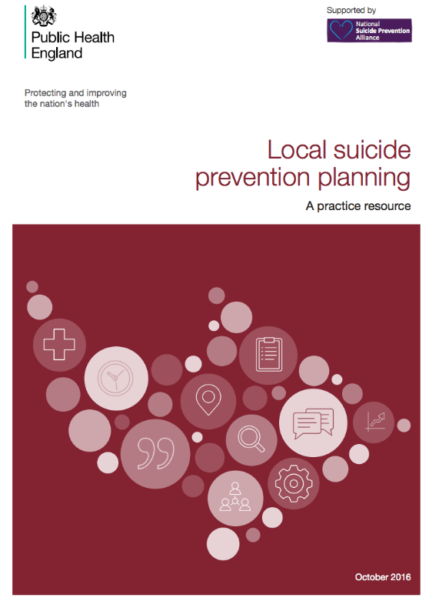
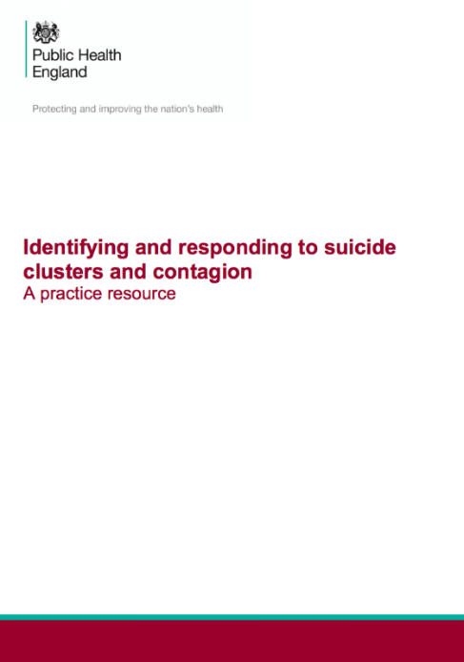
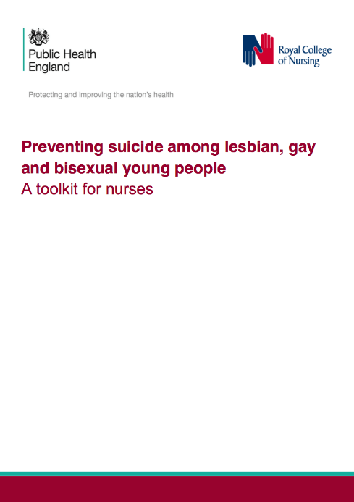
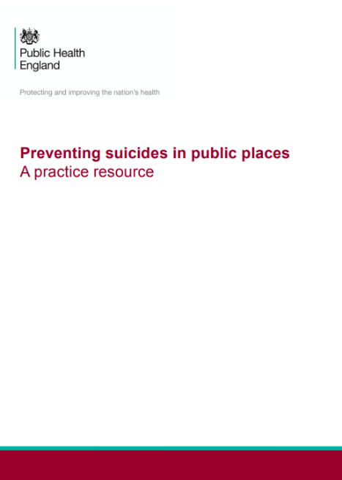
Public Health England resources
Notes:
Other Public Health England resources:
Local suicide prevention planning: a practice resource
Identifying and responding to suicide clusters and contagion: a practice resource
Preventing suicides in public places: a practice resource
Preventing suicide among lesbian, gay and bisexual young people

Slide 49
Section 6
Quotes

Slide 50
Suicide takes a high toll
“The impact of suicide is far-reaching and it remains with family, friends, colleagues and many others long after the individual has gone. The bereavement is often detrimental to performance at work, personal relationships, behaviour and wellbeing.”
Anj Handa Bereaved friend

Slide 51
Every death has a profound impact
"Every life lost represents someone's partner, child, friend or colleague, and their death will profoundly affect people in their family, workplace, club and residential neighbourhood."
Hamish Elvidge Bereaved parent, Chair of Matthew Elvidge Trust

Slide 52
Suicide is preventable
"Suicide is preventable and we must all work together to develop community based suicide prevention plans and activities that reach out to every part of England."
Hamish Elvidge Bereaved parent, Chair of Matthew Elvidge Trust

Slide 53
Role of public health
"Building an approach to suicide reduction and prevention is an area where public health can and should excel in bringing the full range of our skills in the service of our citizens. We each need to undertake a proper assessment of risk and protective factors and influences, an analysis of the wider situation and the engagement and influencing of stakeholders in order to deliver the necessary cross-system action plan.”
Professor Jim McManus
Director of Public Health, Hertfordshire County Council

Slide 54
Preventing suicide is a jigsaw
"Preventing suicide is a jigsaw, which requires many pieces to come together."
Professor Jim McManus
Director of Public Health, Hertfordshire County Council

Slide 55
Lives are important
“Suicide is preventable, we have to remember that. That’s why we have to take more action to let people know their lives are important because when suicidal thoughts are at their strongest it's hard for people to see their own worth.”
James Withey The Recovery Letters

Slide 56
Opportunity to identify and support
"Developing effective and comprehensive local suicide prevention strategies provides the opportunity to identify and support people at risk when they are at the crux of their lives."
James Withey The Recovery Letters

Slide 57
About National Suicide Prevention Alliance
The NSPA is an alliance of public, private and voluntary organisations in England who care about suicide prevention and are willing to take individual and collective action to reduce suicide and support those bereaved or affected by suicide.
Membership enables organisations to share good practice, network and collaborate, as well as amplifying our voice by speaking together.
It’s free to join!
For more information contact info@nspa.org.uk
www.nspa.org.uk

Slide 58
About Public Health England
Public Health England exists to protect and improve the nation’s health and wellbeing, and reduce health inequalities. We do this through world-class science, knowledge and intelligence, advocacy, partnerships and the delivery of specialist public health services. We are an executive agency of the Department of Health, and are a distinct delivery organisation with operational autonomy to advise and support government, local authorities and the NHS in a professionally independent manner.
Public Health England Tel: 020 7654 8000 http://www.gov.uk/phe
Twitter: @PHE_uk Facebook: http://www.facebook.com/PublicHealthEngland
© Crown copyright 2016 You may re-use this information (excluding logos) free of charge in any format or medium, under the terms of the Open Government Licence v3.0. To view this licence, visit OGL or email psi@nationalarchives.gsi.gov.uk. Where we have identified any third party copyright information you will need to obtain permission from the copyright holders concerned.

